Slide 1
TEM Compile and Run Guide
Licheng Liu

Slide 2
0. Preparation
PC version: download from dropbox link here: https://www.dropbox.com/s/ue8ceri6b3j7qar/tem.zip?dl=0
PC version: Visual Studio 2019 from Purdue software (and VS2010 if you can)
Cluster version: download client xtermmoba https://mobaxterm.mobatek.net/download-home-edition.html
portable version.
Cluster version: Copy all folders from cluster: /group/ebdl/data/licheng/TEM_model_guide/
Cluster version: use command:
module load intel
module load impi

Slide 3
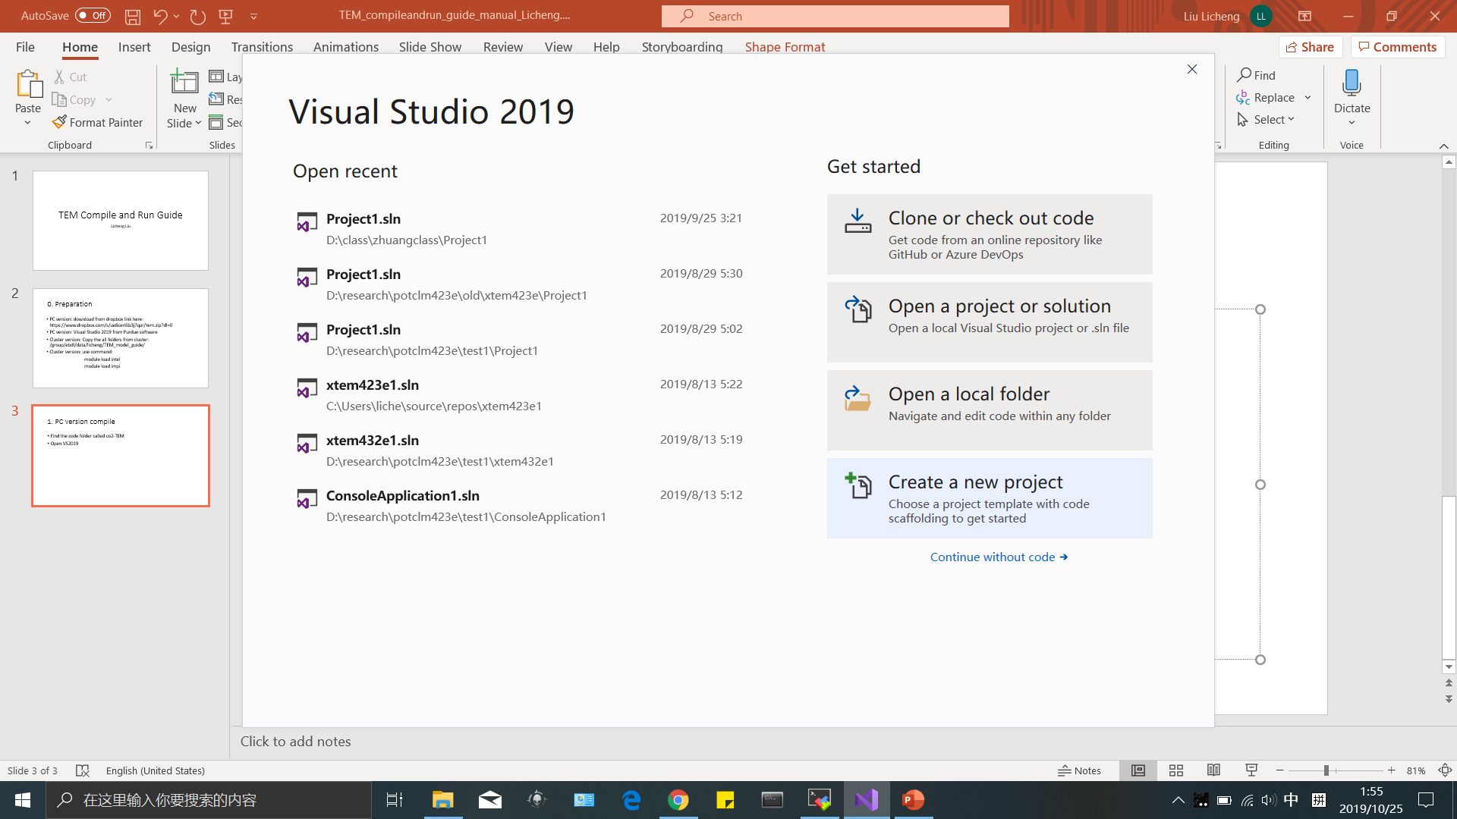
1. PC version compile
Find the code folder called co2-TEM
Open VS2019, create a new project

Slide 4
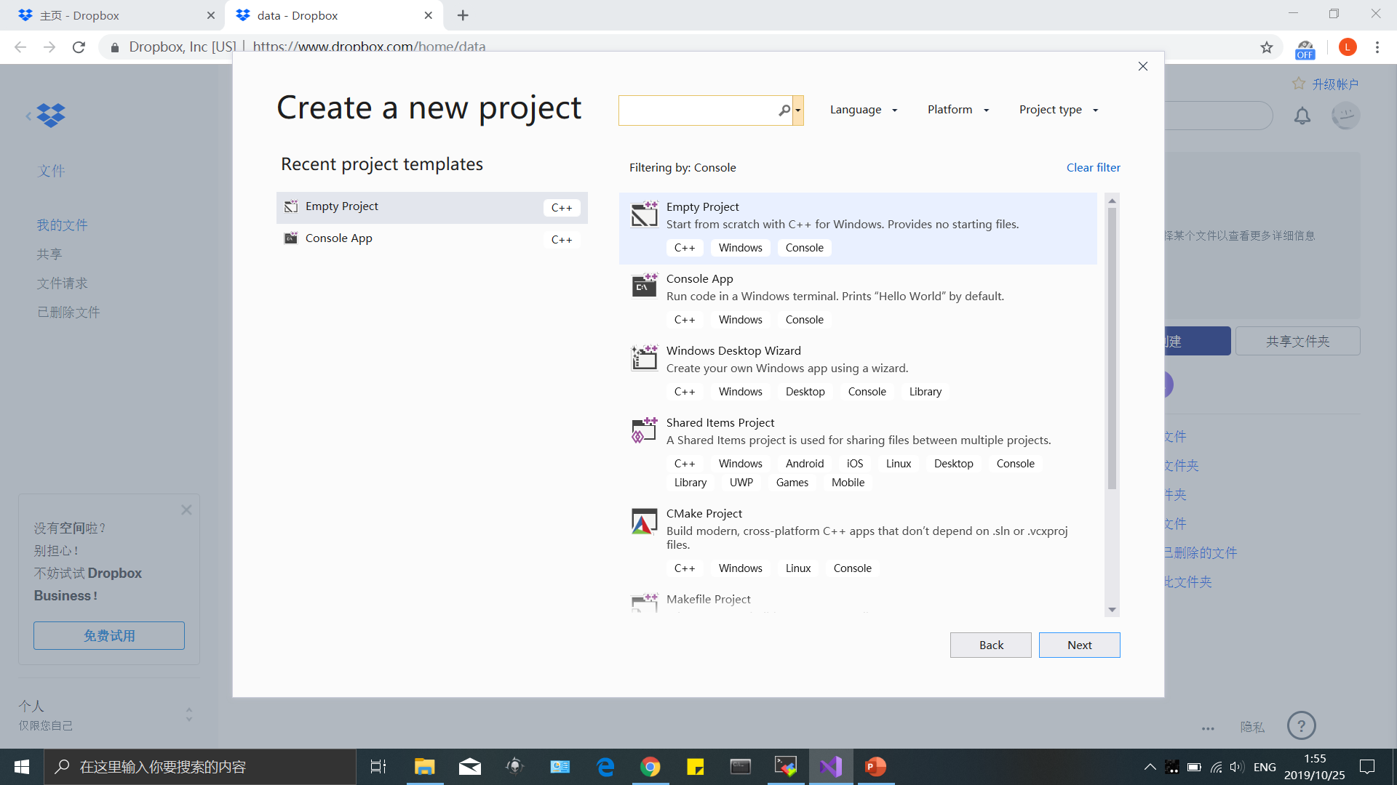
1. PC version compile:
Empty project -> next

Slide 5
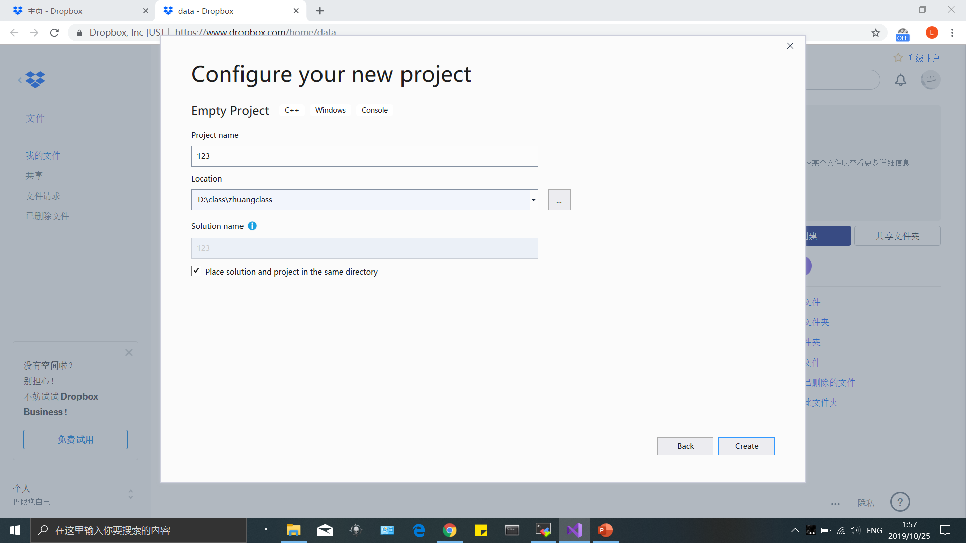
1. PC version compile:
Fill in any name you want

Slide 6
1. PC version compile:
Fill in any name you want→ create

Slide 7
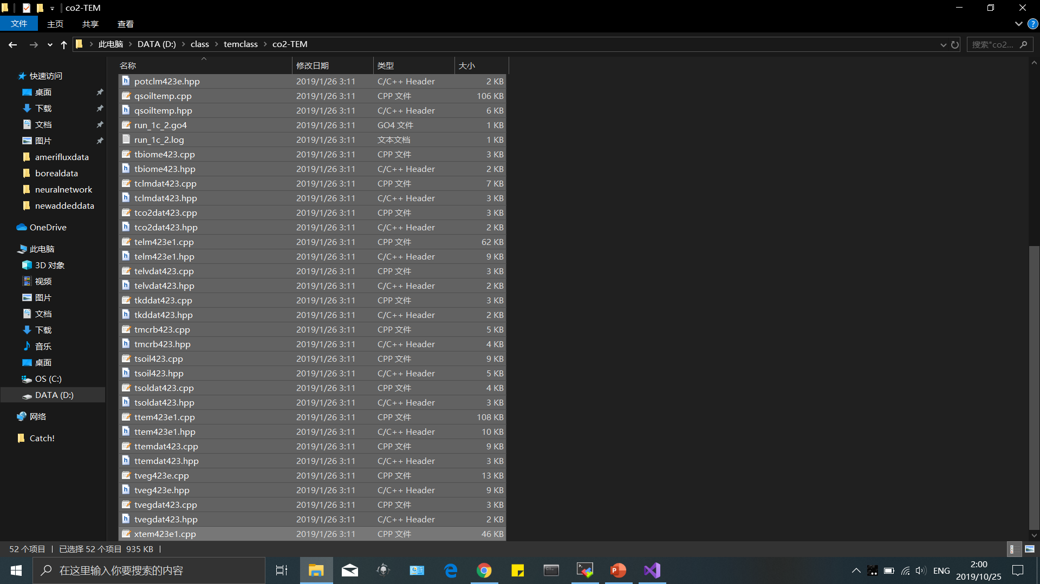
1. PC version compile:
Copy all file in co2-TEM folder into your project folder. Like my D:\class\zhuangclass\123

Slide 8
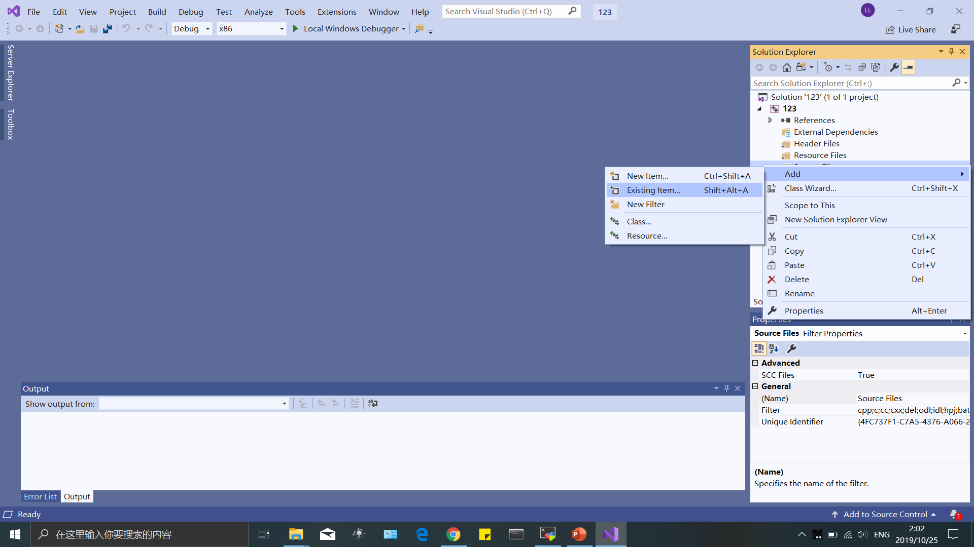
1. PC version compile:
Right click “source file” in VS2019 -> add -> existing item

Slide 9
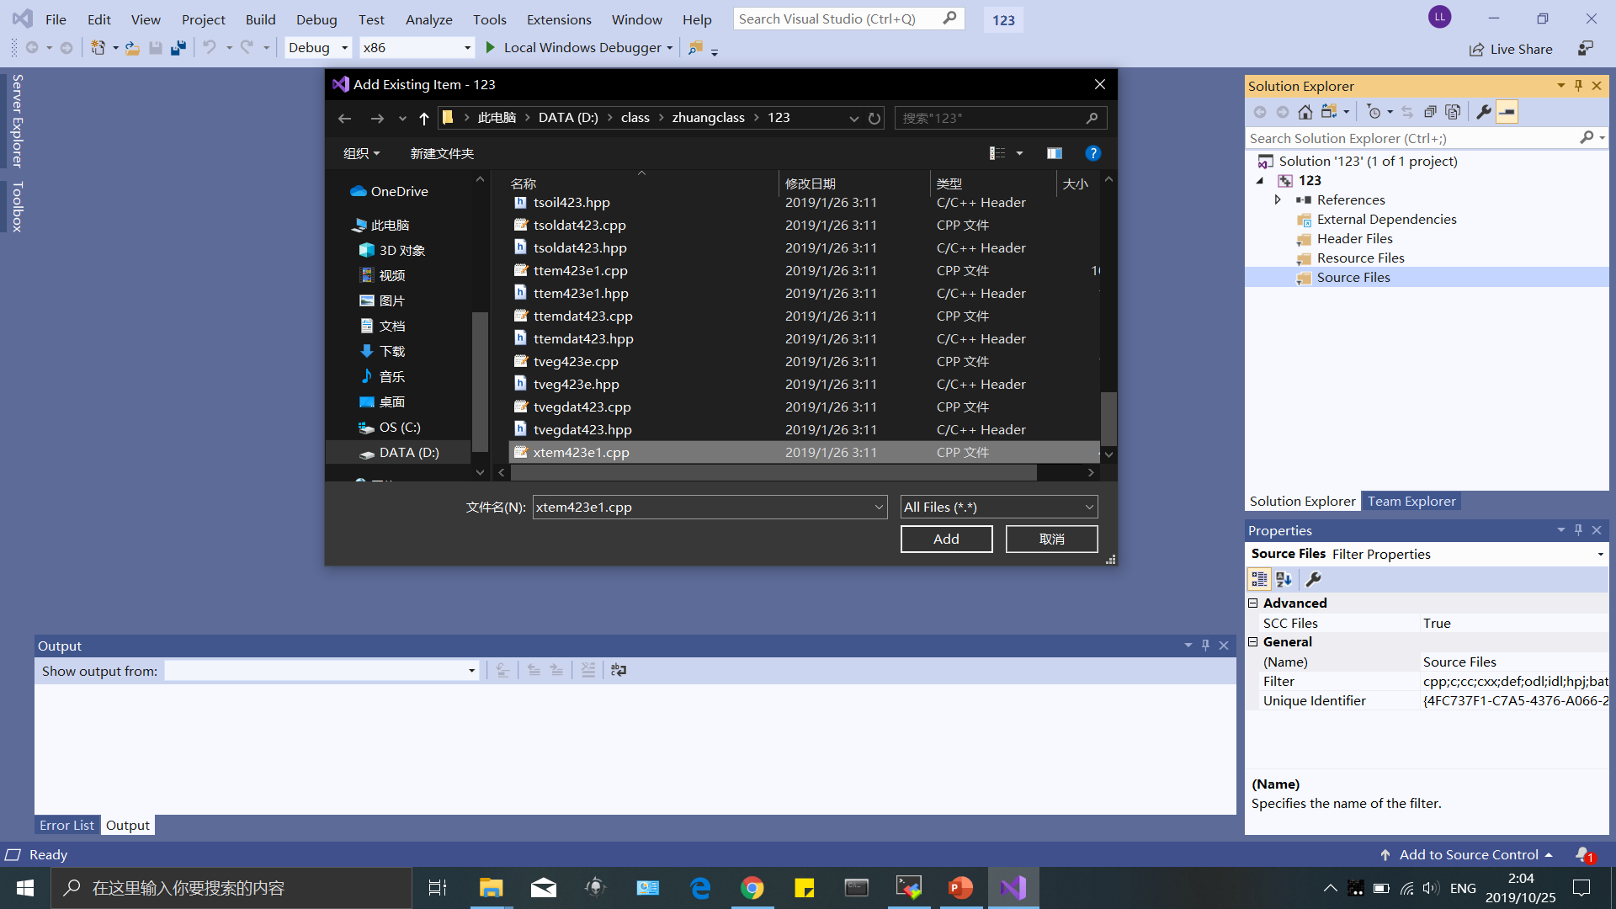
1. PC version compile:
Choose the main cpp file called “xtem423e1.cpp” -> add

Slide 10
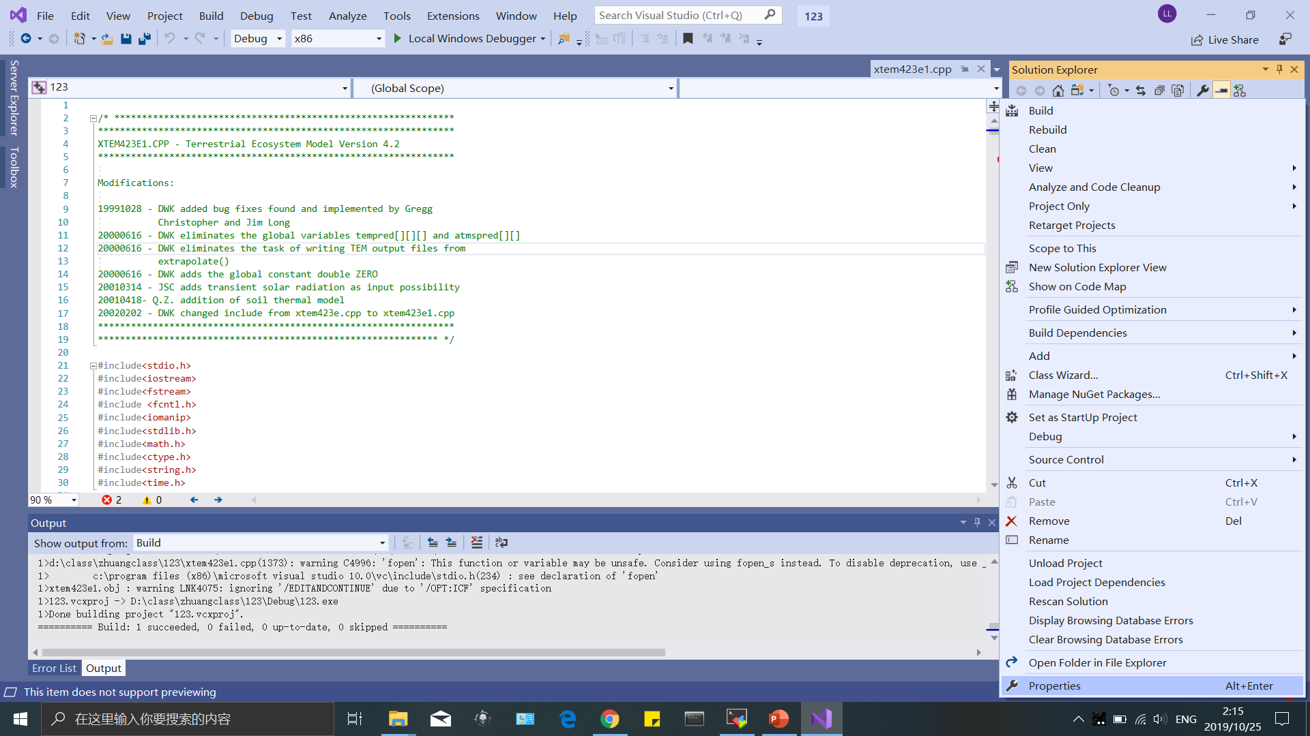
1. PC version compile:
Here you should notice, all PC version can be compiled without efforts using VS2010. If you can get one, you can right click Project name “123” -> properties

Slide 11
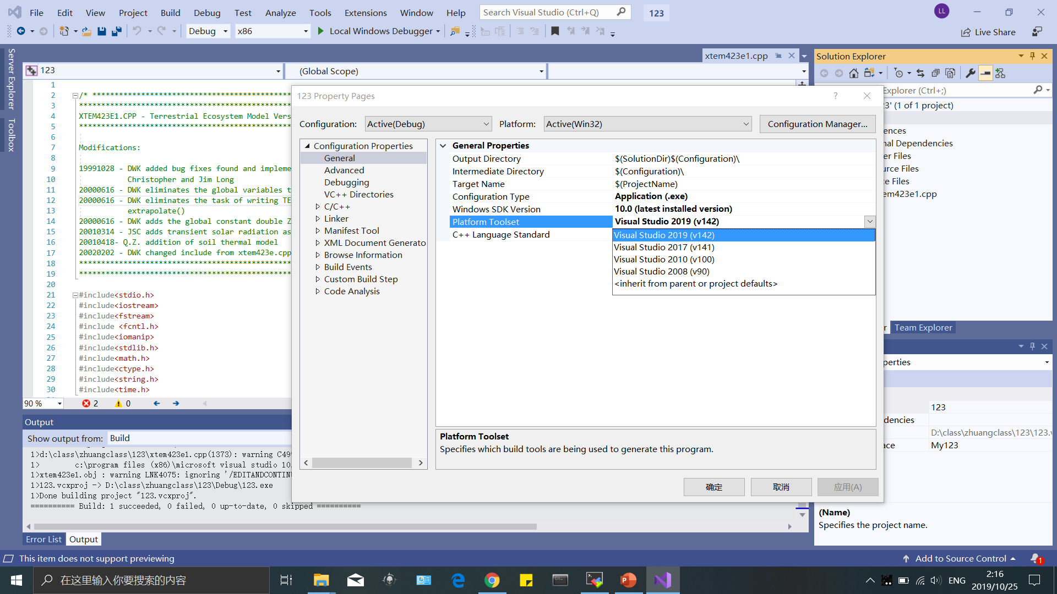
1. PC version compile:
Change platform into VS2010 and apply

Slide 12
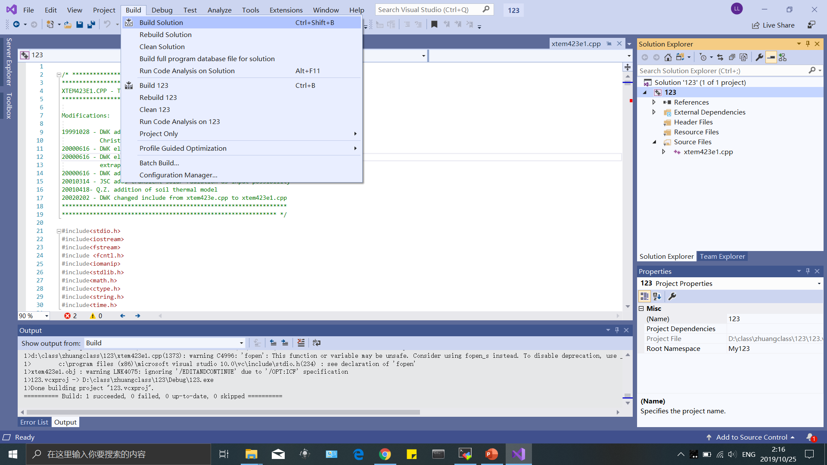
1. PC version compile:
Build solution -> if successful, you will get message at bottom box like me. If you don’t have VS2010, you need to fix any bug showed in massage box

Slide 13
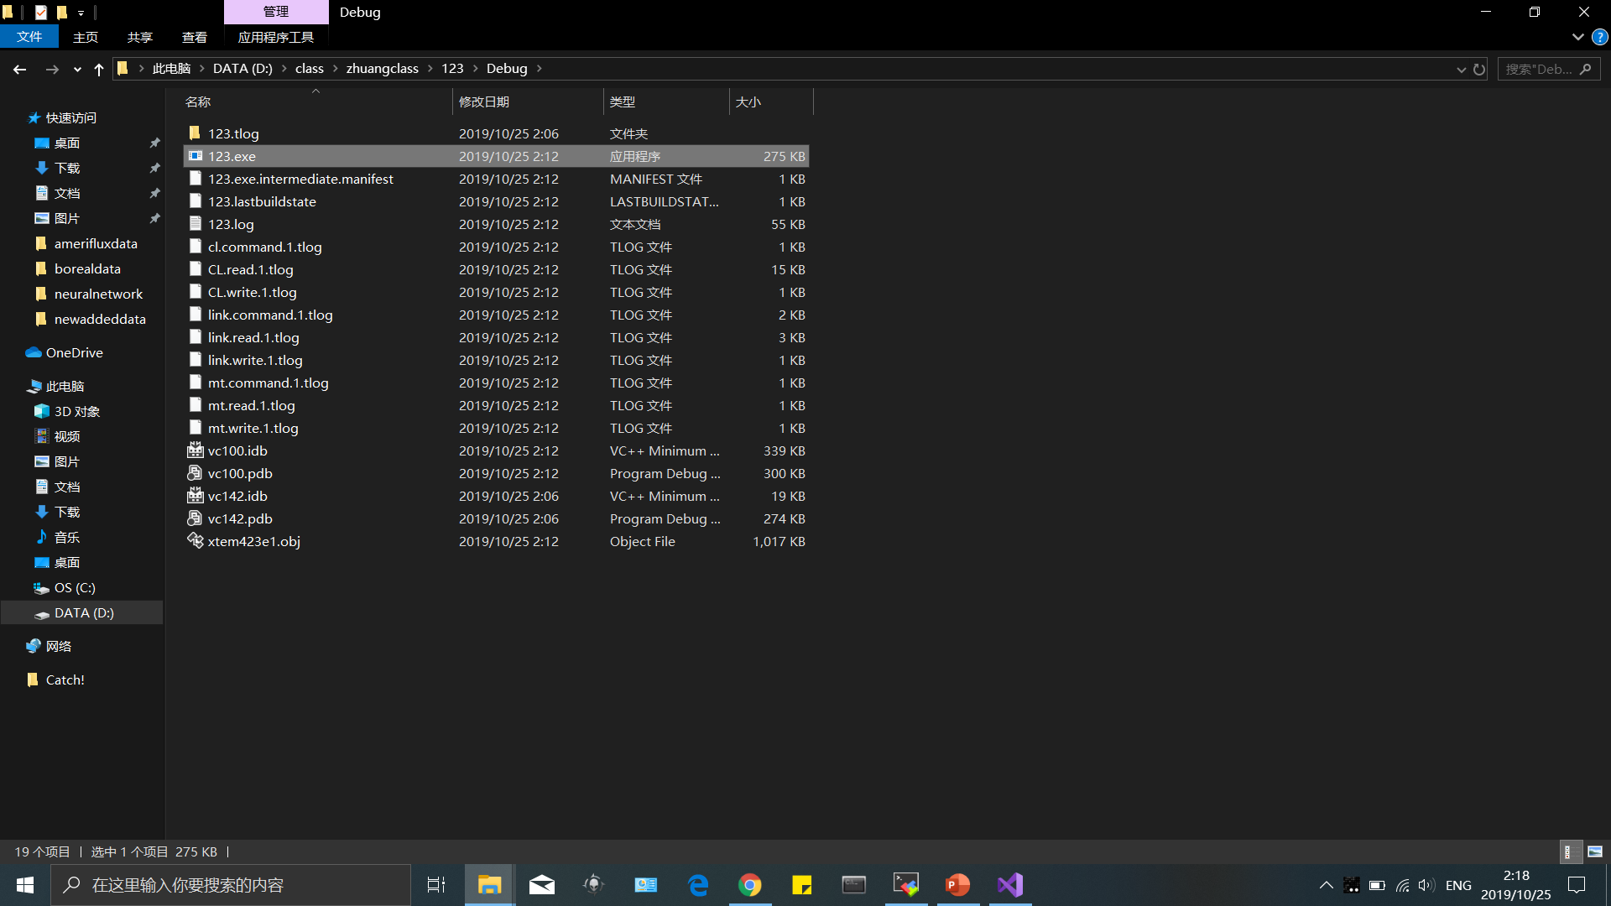
1. PC version run:
After compiling, you will get a 123.exe in debug folder. That is TEM model application file. Copy that into run folder “run-part401”

Slide 14
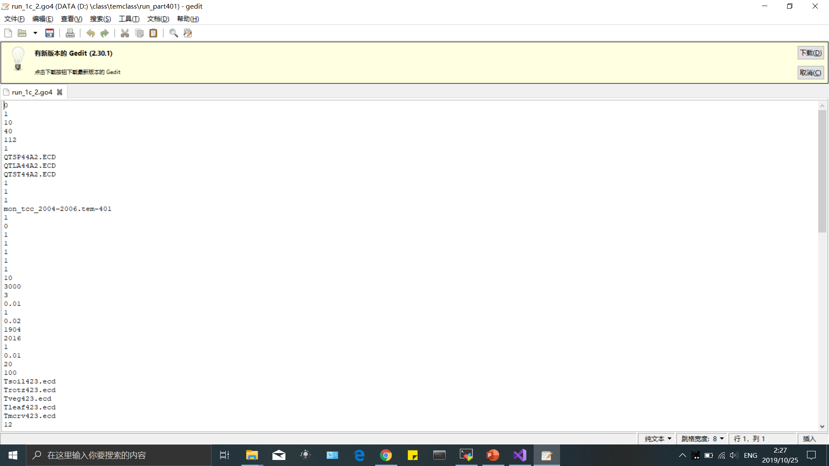
1. PC version run:
In order to run the model, you need to prepare three kinds of files: parameter files, showed as *.ecd or *.dat in run foler; forcing data file like T, Prec, Clds*.TEM-401 and soil property data like *.glb; Para file run_1c_2.go4 contains all questions answer. Questions can be found in run_1c_2.log. All files should be in the same folder.

Slide 15
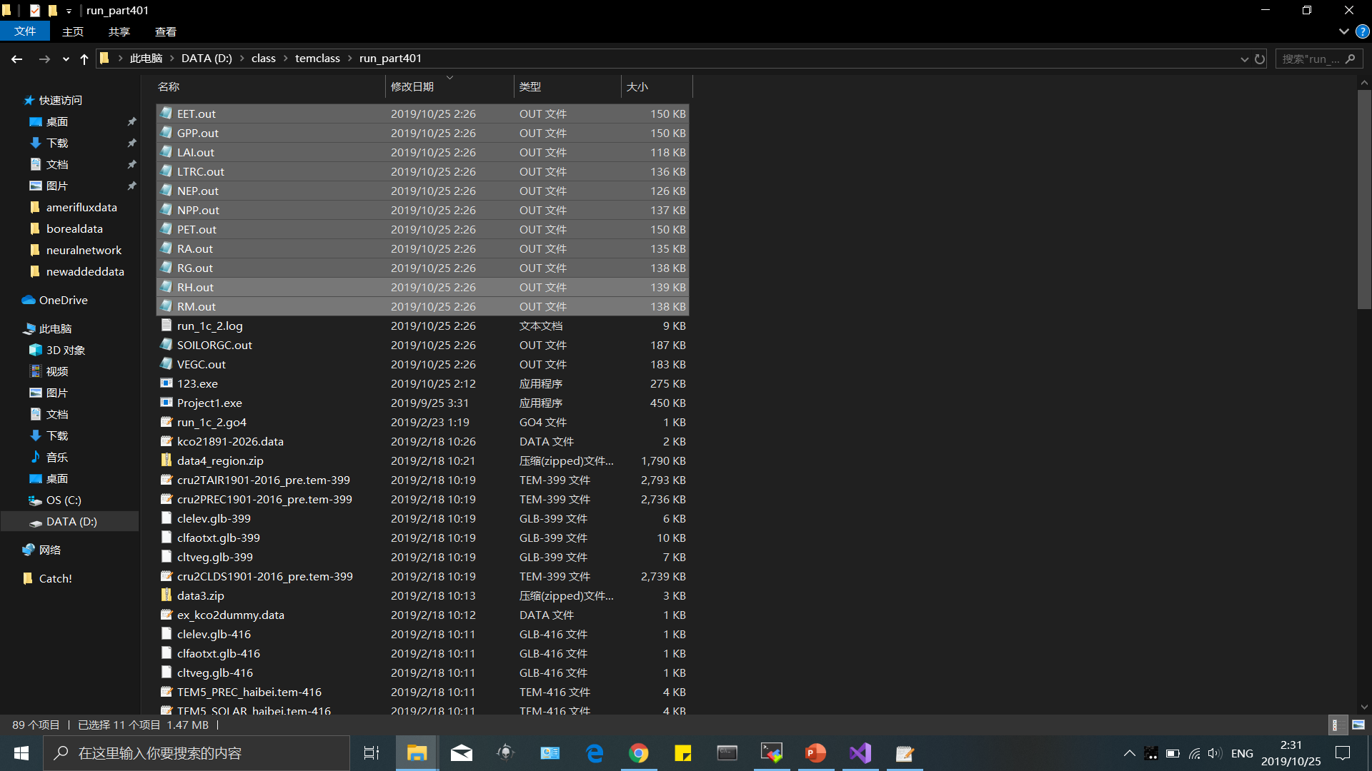
1. PC version run:
Basically, if you want to run the model for your specifical time period and region, you need to prepare only forcing data and soil properties data for that period. If run successfully, you will get *.out file, which are model output.

Slide 16
Model simulations
One Simulation
Data input
Model
Results

Slide 17
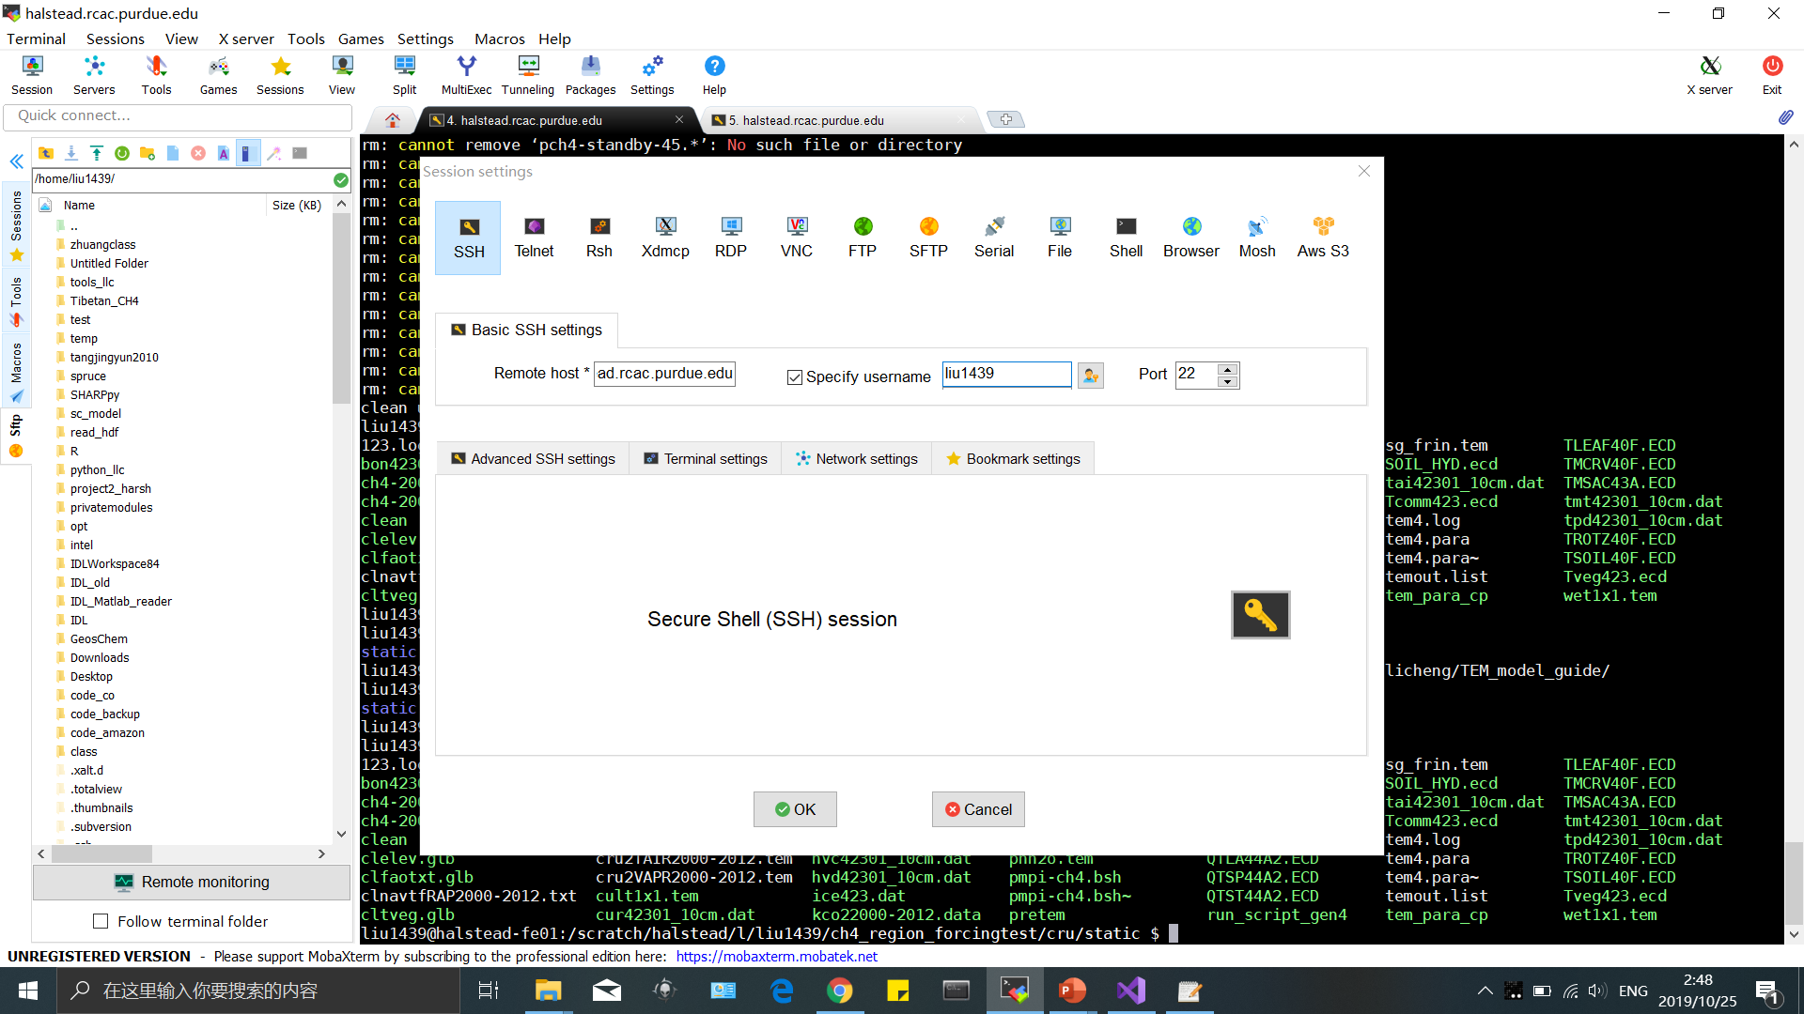
2. Cluster version compile: Linux evironment
Connect to our cluster using xterm moba client:
Host: halstead.rcac.purdue.edu username: your career account name. You need permission from Prof. Zhuang

Slide 18
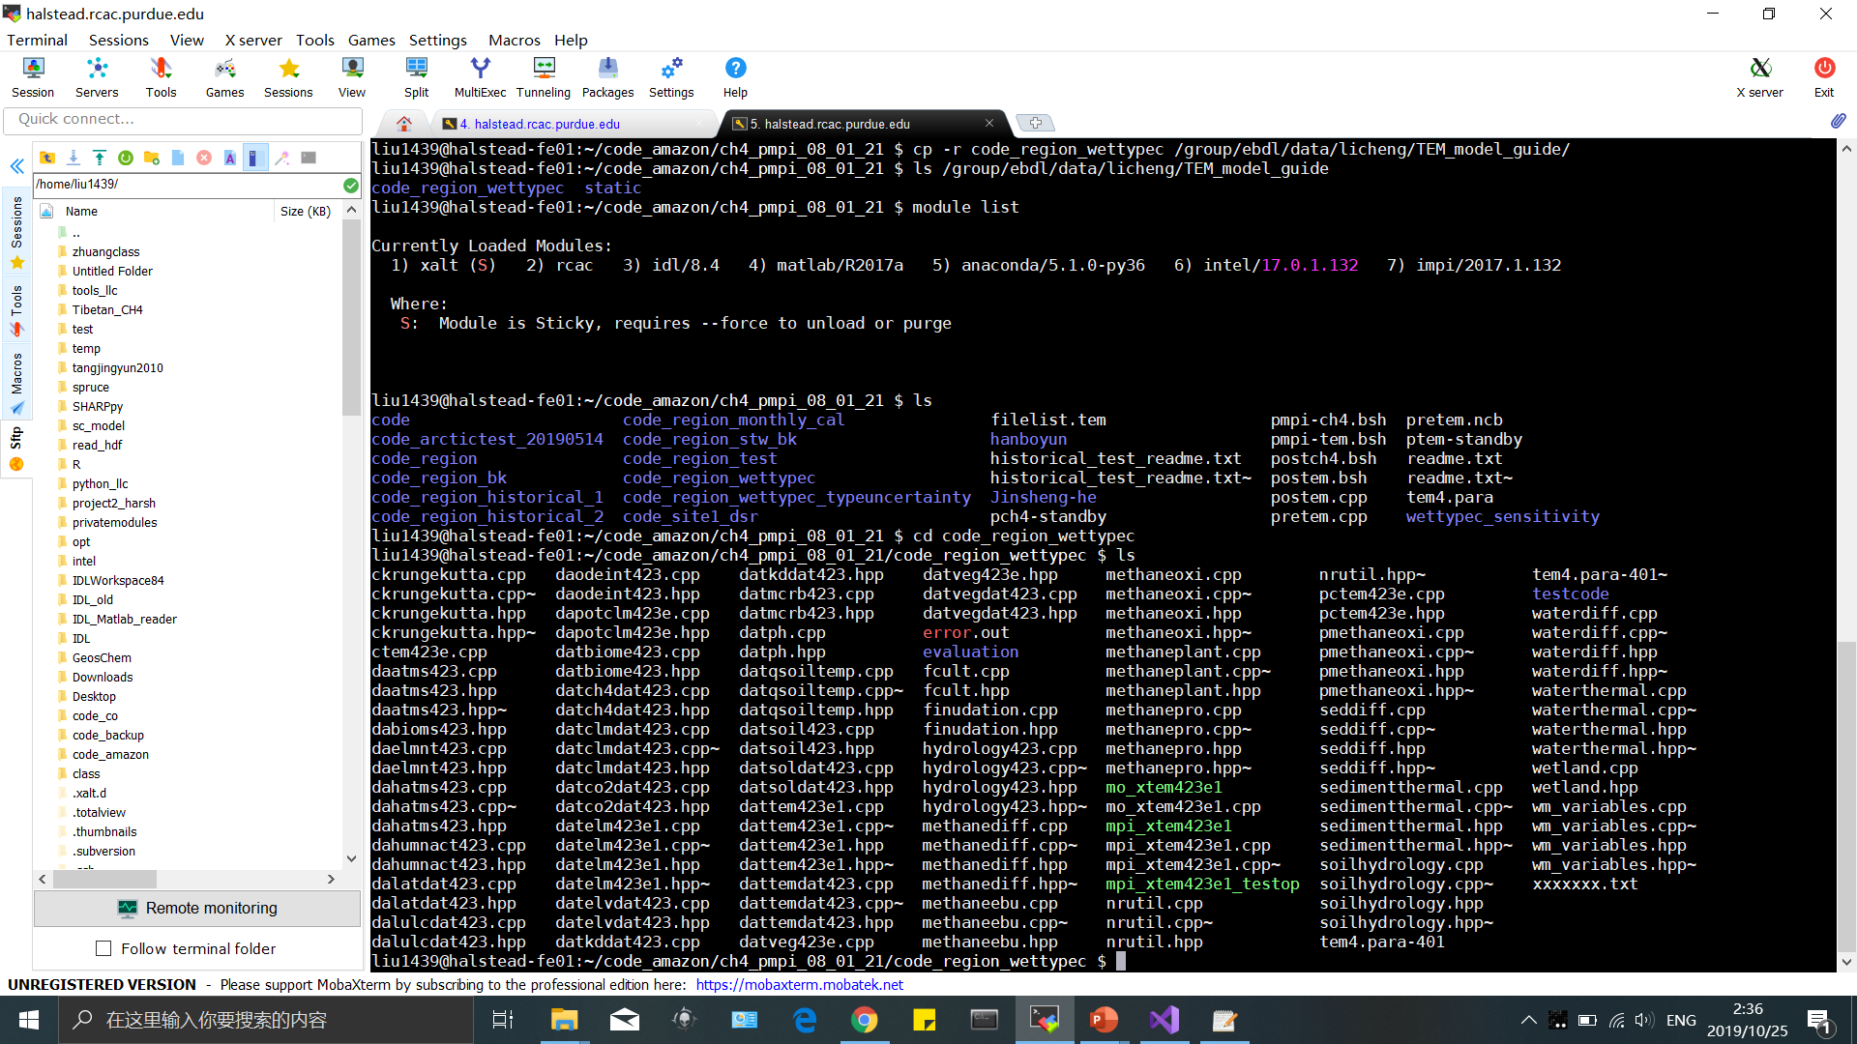
2. Cluster version compile: Linux evironment
Copy all files from /group/ebdl/data/licheng/TEM_model_guide/
Into your own folder. cd code_region_wettypec

Slide 19
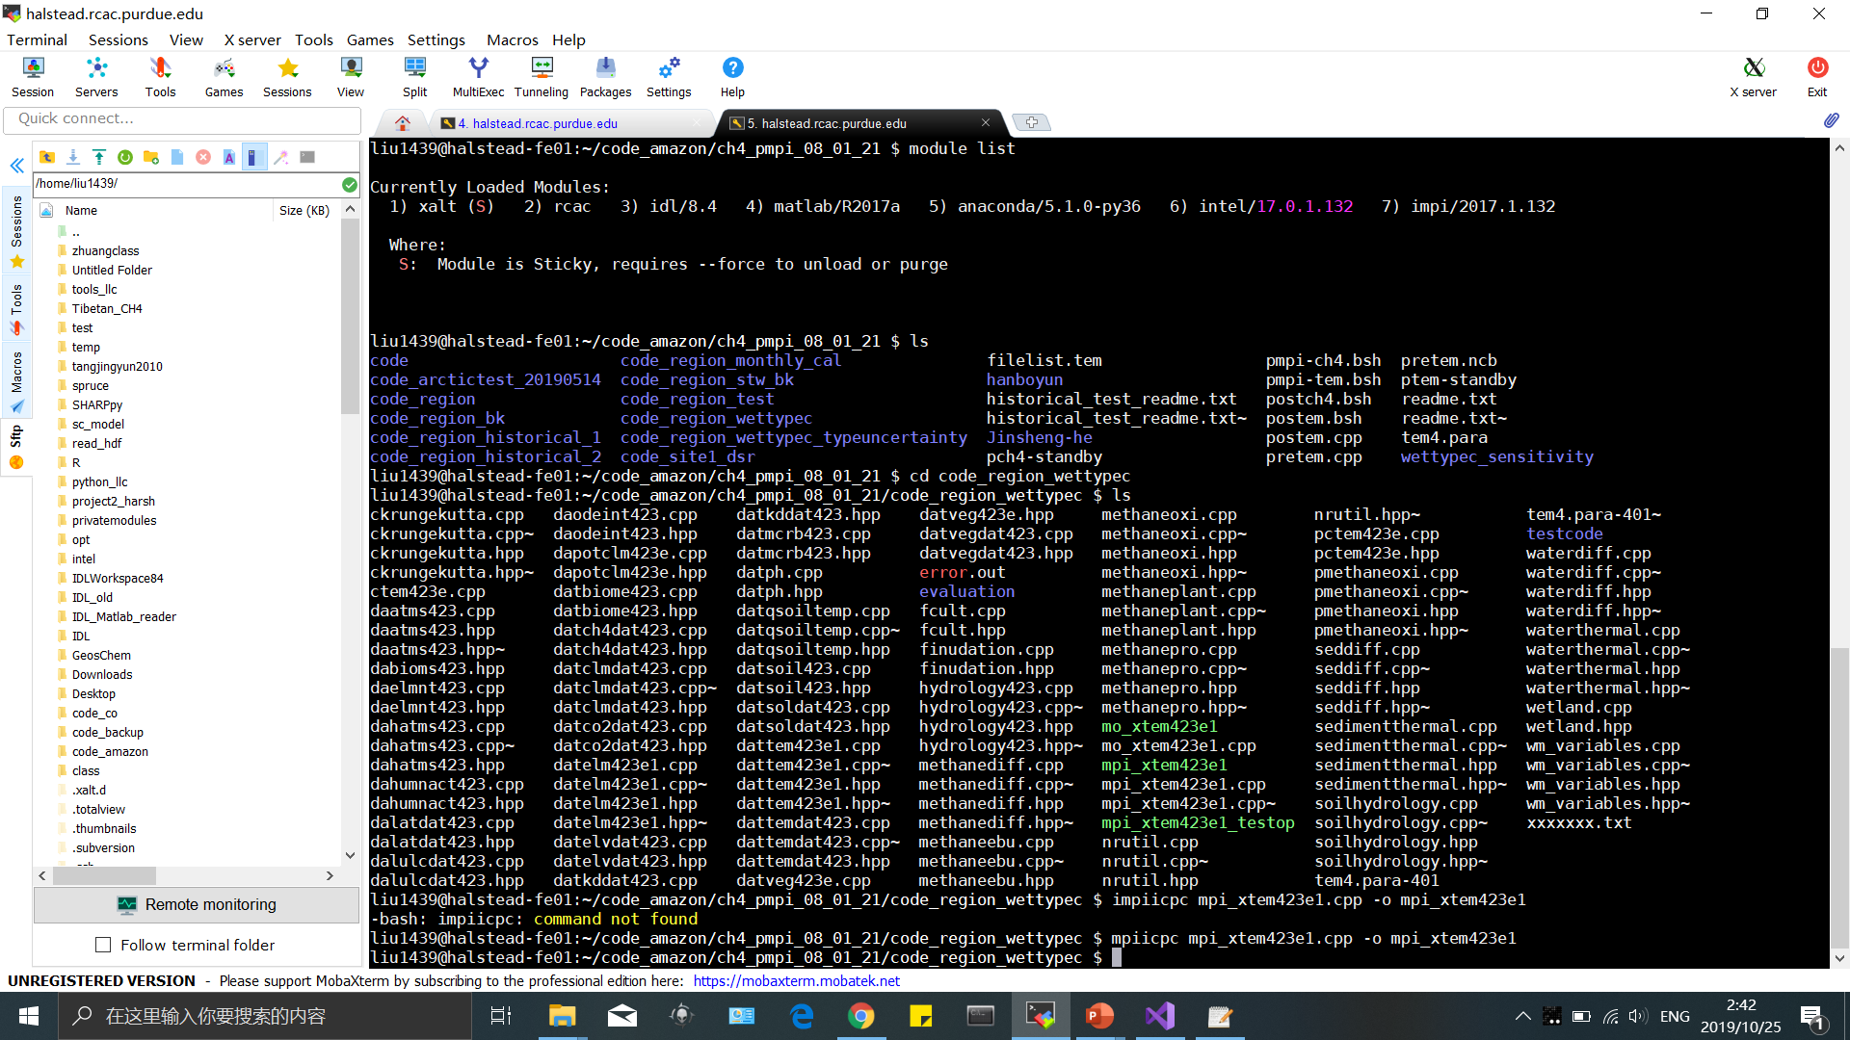
2. Cluster version compile:
You can always find the right compiling commands using Google search keywords like “Purdue cluster impi compiling”. Now the compiling command for current impi is:
mpiicpc mpi_xtem423e1.cpp -o mpi_xtem423e1

Slide 20
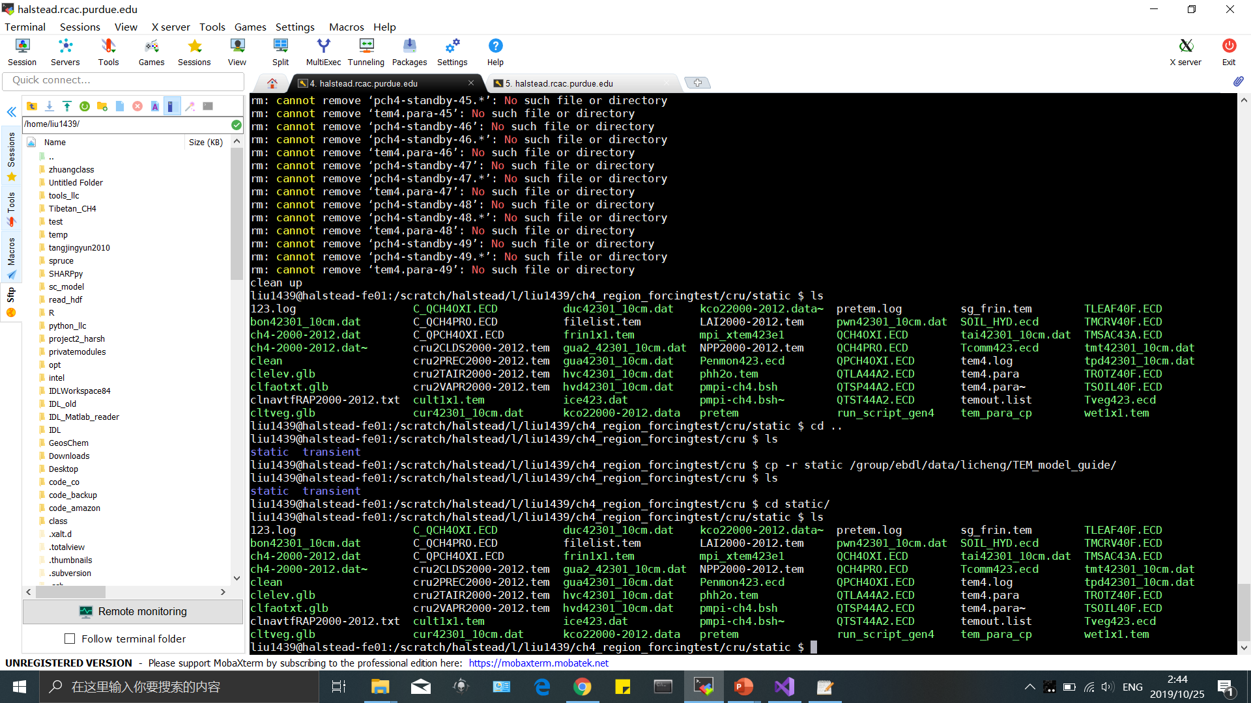
2. Cluster version run:
After compile you will get an application file called mpi_xtem423e1. Compy that into the run folder “static”

Slide 21
2. Cluster version run:
Similarly, we need parameter files *.ecd and *.dat; Forcing data file like *.tem and soil texture data *.glb; and parafile tem4.para. Questions can be found in tem4.log

Slide 22
2. Cluster version run:
Different part for cluster is, normally you run parallel version TEM model which need mpi software and forcing data cutting. Thus we need other few files:
pmpi-ch4.bsh
pretem
run_script_gen4
tem_para_cp
filelist.tem

Slide 23
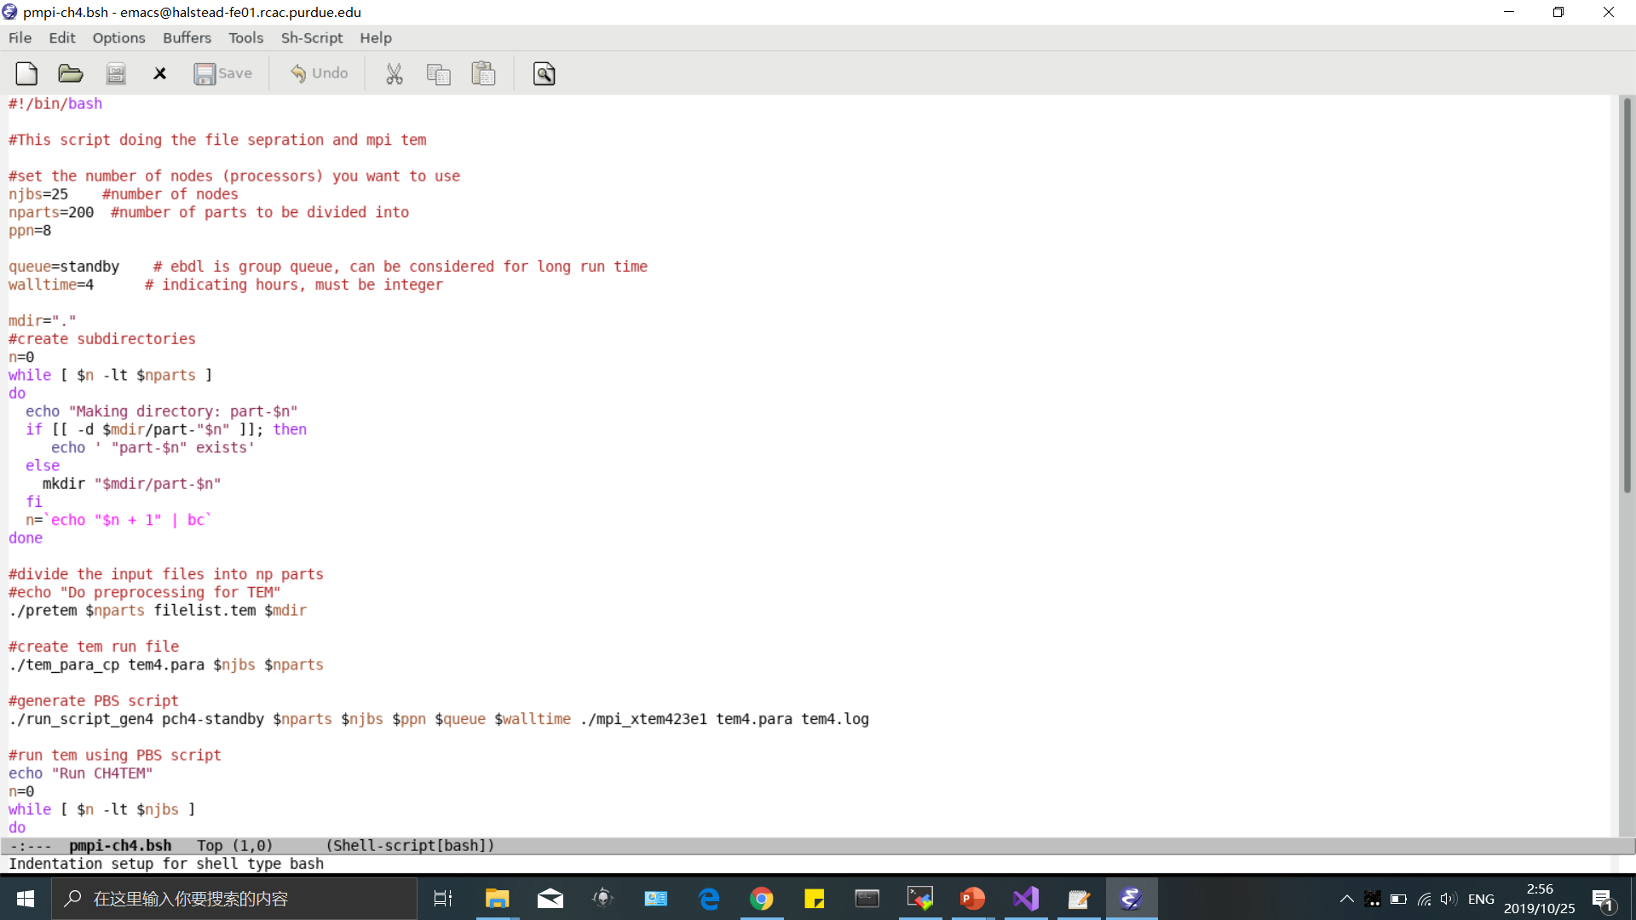
2. Cluster version run:
Contains all linux command for running model. If you want to run the model, just use command ./pmpi-ch4.bsh. The data will be cut into 200 parts and submit 25 jobs, and each job run 8 parts
pmpi-ch4.bsh
pretem
run_script_gen4
tem_para_cp
filelist.tem

Slide 24
2. Cluster version run:
These three files are applications. Pretem separate the data; tem_para_cp copy tem4.para file for each job; run_script_gen4 generates job submitting files for cluster.
pmpi-ch4.bsh
pretem
run_script_gen4
tem_para_cp
filelist.tem

Slide 25
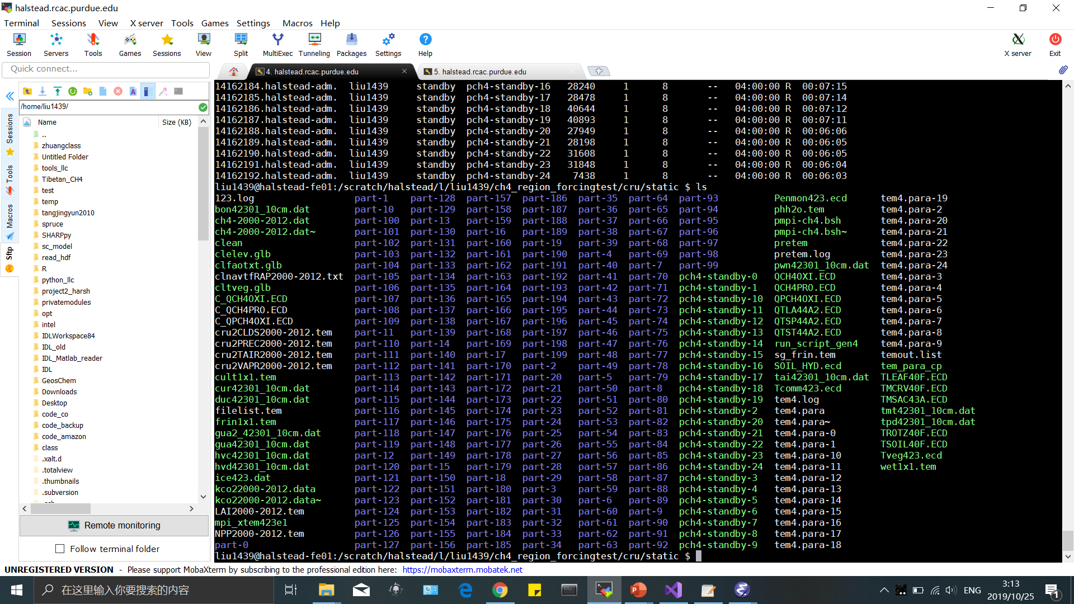
2. Cluster version run:
After you run the model using ./pmpi-ch4.bsh, the model will first separate files into different folder, copy tem4.para like tem4.para-* * is from 0 to 24;

Slide 26
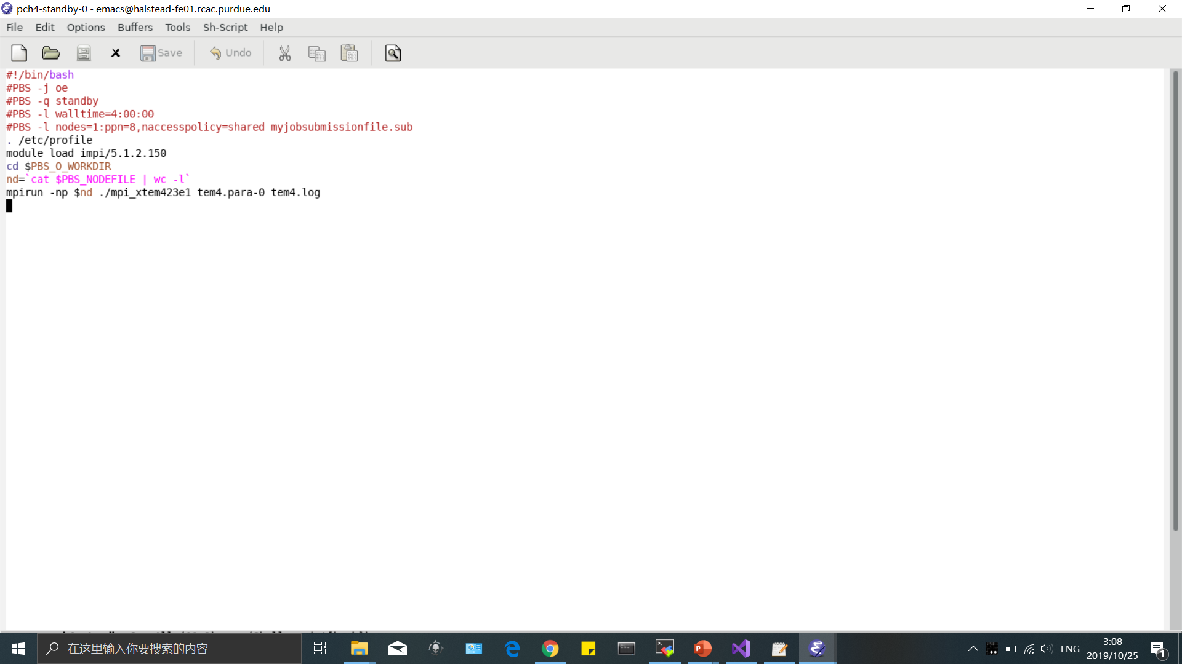
2. Cluster version run:
Then it will generate pch4-standby-* * from 0 to 24 for job submitting.

Slide 27
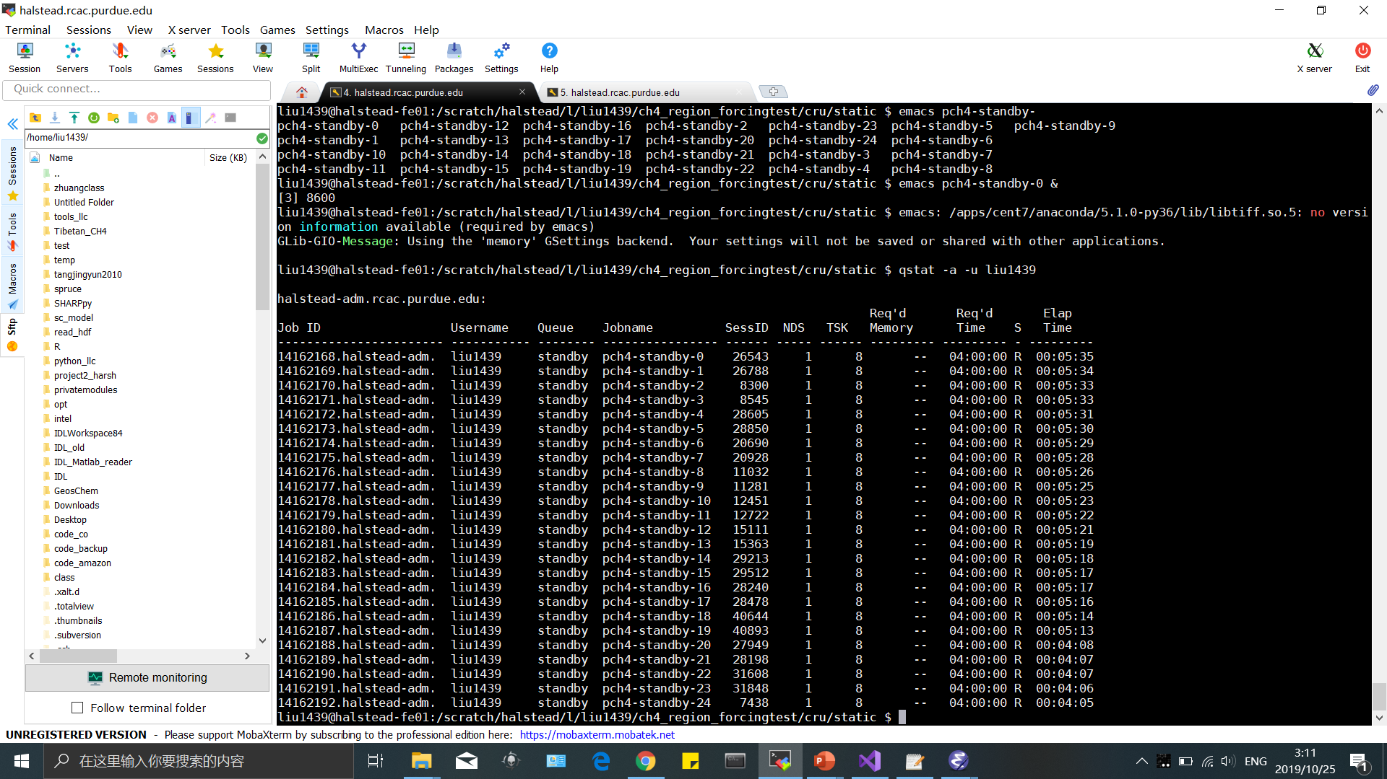
2. Cluster version run:
If all jobs submitted successfully, you can use:
qstat -a -u liu1439 (your own username)
To find the stats of your jobs. In S column, R means run, Q means queue, E erro and C cancel

Slide 28
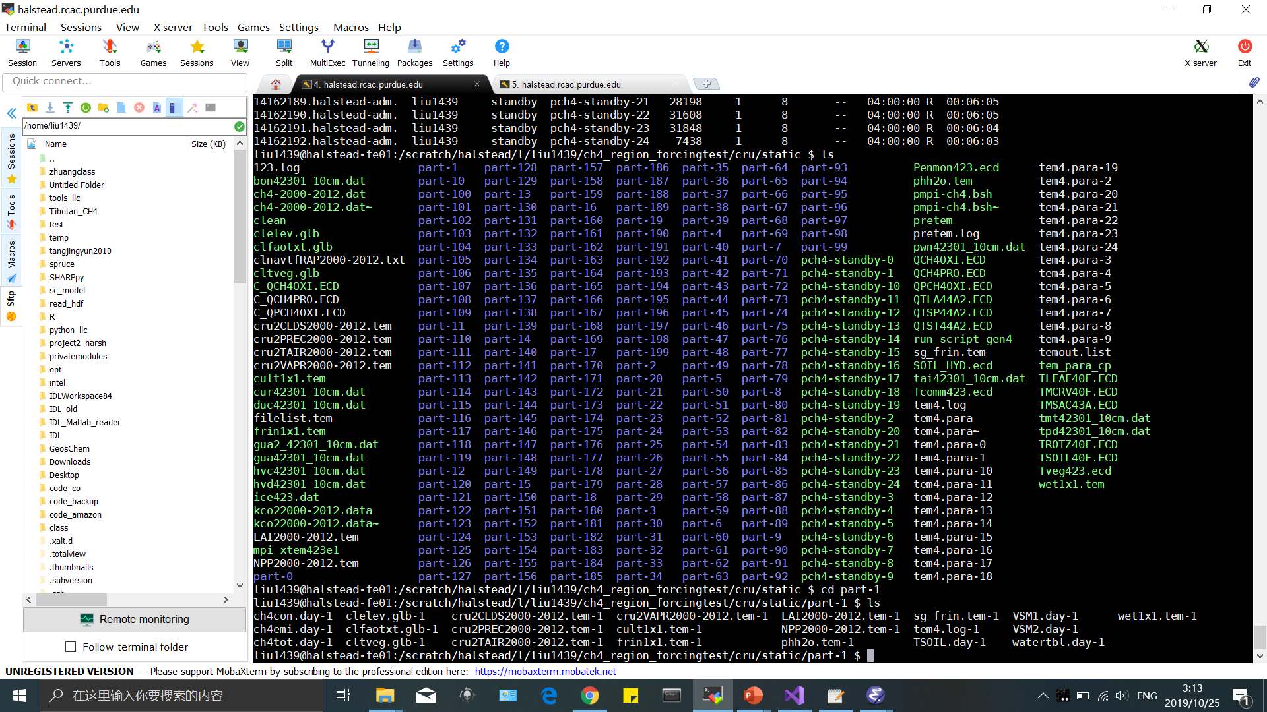
2. Cluster version run:
After simulation finished, all output files can be found in each part folder. Like here part-1/*.day-1 are data output

